Slide 1


Amazon Sales Analysis Report

Slide 2

Introduction
In the competitive e-commerce landscape, effective sales management is essential for reducing costs and increasing profits.
This project leverages Python and visualization tools to analyze Amazon sales data, uncovering trends and key metrics.
By examining monthly and yearly sales patterns, we aim to provide actionable insights into sales performance.
These insights will help drive strategic decisions and enhance overall business success.

Slide 3
Problem Statement
Sales management has gained importance due to increasing competition and the need for improved distribution methods to reduce costs and increase profits.
It is now the most important function in a commercial and business enterprise. Effective sales management not only drives revenue growth but also enhances customer satisfaction and loyalty.
By analyzing sales data, businesses can identify trends, optimize strategies, and make informed decisions to stay ahead in the market.

Slide 4
Project Objective
ETL Process: Extract, transform, and load an Amazon dataset.
Sales Trend Analysis: Identify sales trends month-wise, year-wise, and yearly-month-wise.
Key Metrics and Relationships: Determine key metrics and factors, and show meaningful relationships between attributes.

Slide 5
Key Metrics
Total Revenue:
$137.35 M
Total Profit:
$44.17 M
Unit Sold:
512871
Average Unit Price:
$276.76
Average Unit Cost:
$191.05

Slide 6
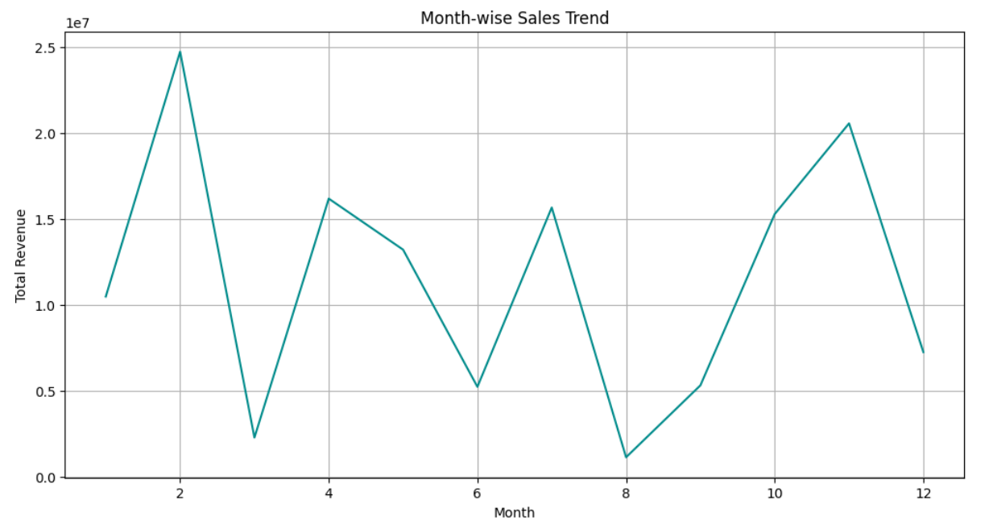
Visualizing Sales Trend: Month-Wise
Peak Sales:
February
November
Lowest Sales:
March
August
Sharp Increase:
Jan to Feb
Sharp decline:
Feb to Mar
Nov to Dec

Slide 7
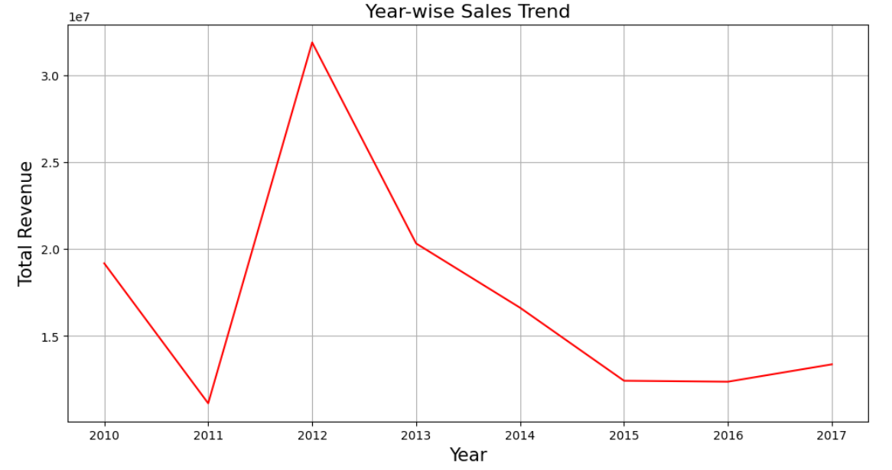
Visualizing Sales Trend: Year-Wise
Peak Sales Year:
2012
Lowest Sales Year:
2011
2016
2010-2011:
Decline
2011-2012:
Sharp increase

Slide 8
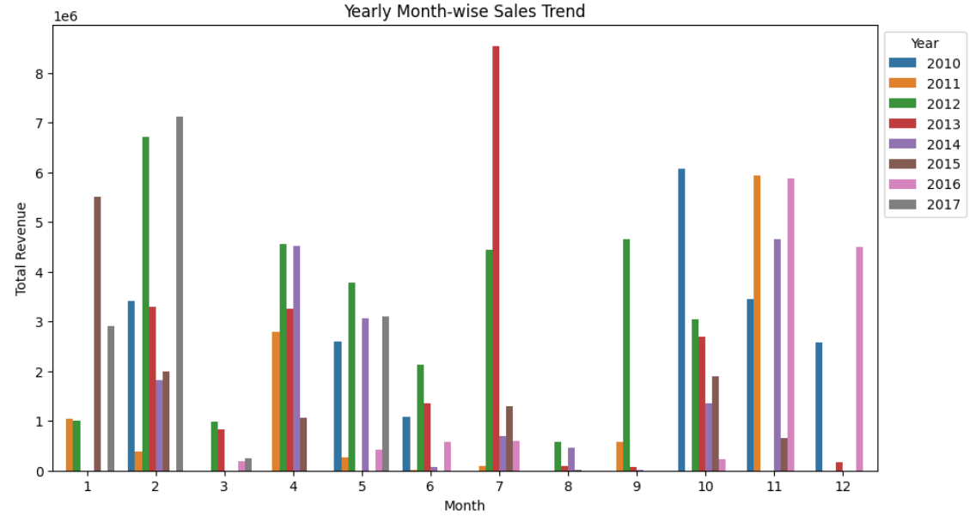
Visualizing Sales Trend: Yearly Month-Wise
High Sales Months: January, February, April, July, and October consistently show high sales across multiple years.
Low Sales Months: March, May, June, August, and September often have lower sales.
Notable Peaks: Specific years have unique peaks, such as October in 2010, April and December in 2011, February in 2012 and July in 2013.

Slide 9
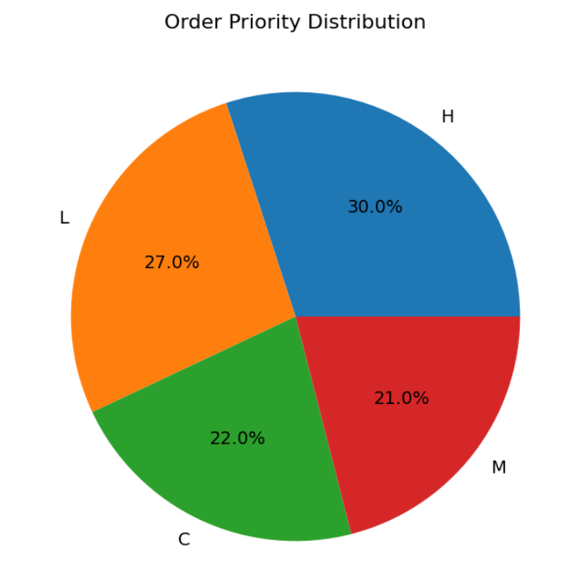
Visualizing Order Priority Distribution
The “Order Priority Distribution” pie chart shows:
High Priority (H): 30.0%
Low Priority (L): 27.0%
Critical ©: 22.0%
Medium (M): 21.0%

Slide 10
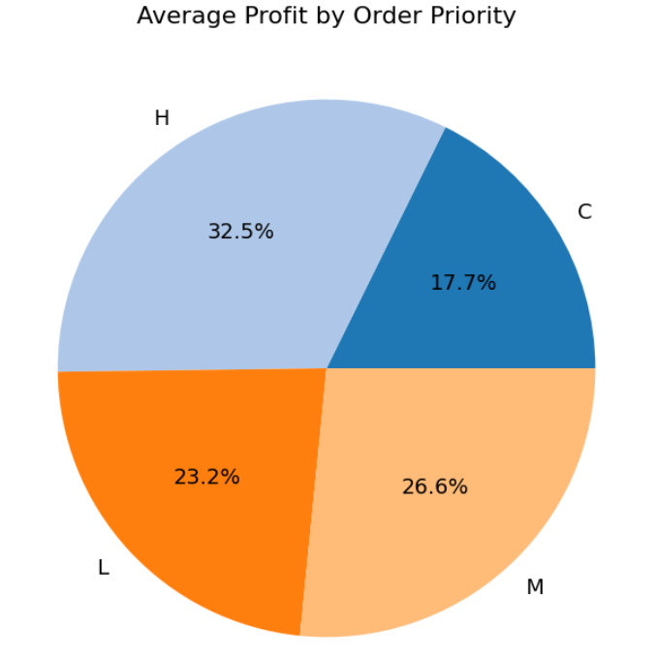
Average Profit by Order Priority
The “Average Profit by Order Priority” pie chart shows:
High Priority (H): 32.5%
Medium (M): 26.6%
Low Priority (L): 23.2%
Critical ©: 17.7%

Slide 11
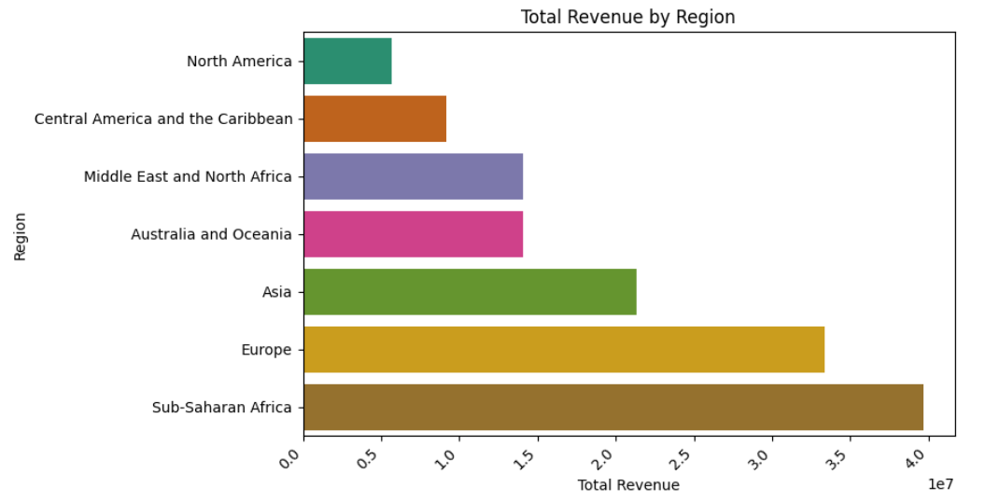
Total Revenue By Reason
Sub-Saharan Africa:
Generates the Highest revenue
Europe and Asia:
Generate Moderate amount of revenue
North America:
Generates Lowest Revenue

Slide 12
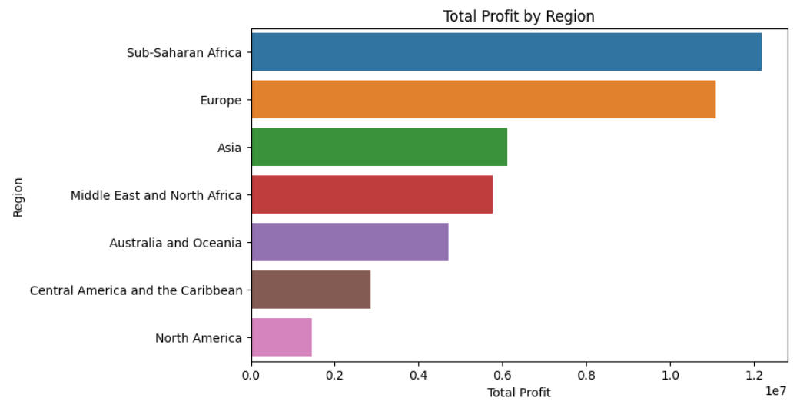
Total Profit By Region
Sub-Saharan Africa and Europe: Generates Highest Profit
Asia, Middle East and North Africa: Generate Moderate Profit
North America: Generates Lowest Profit

Slide 13
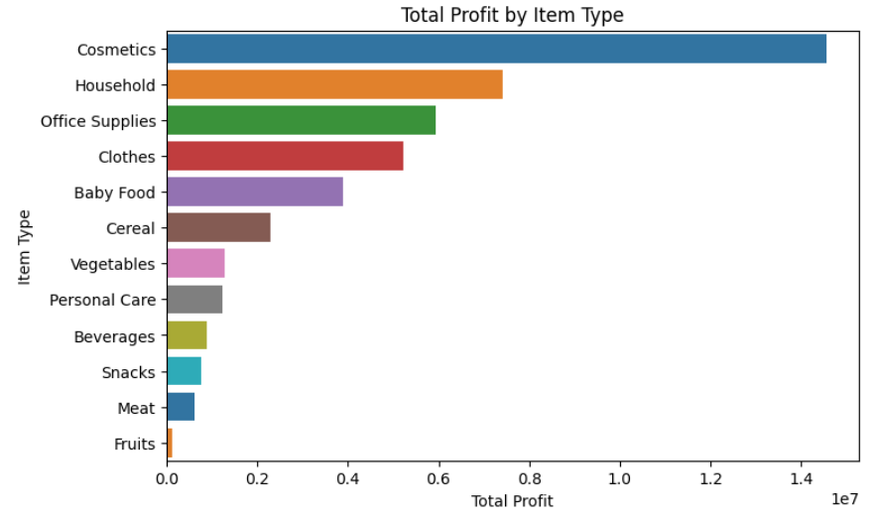
Total Profit by Item Type
Highest Profit:
Cosmetics
Next Highest:
Household items
Office Supplies
Significant Profits:
Clothes
Baby Food
Lowest Profits:
Fruits
Meat

Slide 14
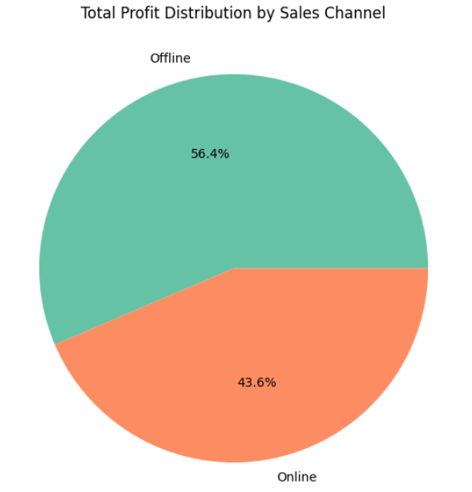
Total Profit Distribution by Sales Channel
Offline Sales:
56.4% of total profit
Online Sales:
43.6% of total profit
Offline sales are more profitable in this scenario.

Slide 15
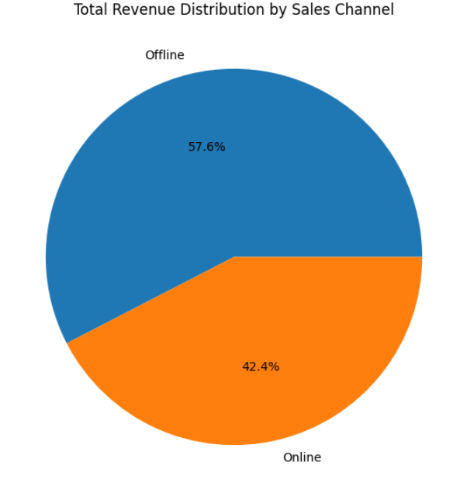
Total Revenue: Distribution by Sales Channel
Offline Sales:
57.6% of total revenue
Online Sales:
42.4% of total revenue
Offline sales are the dominant revenue source in this scenario.

Slide 16
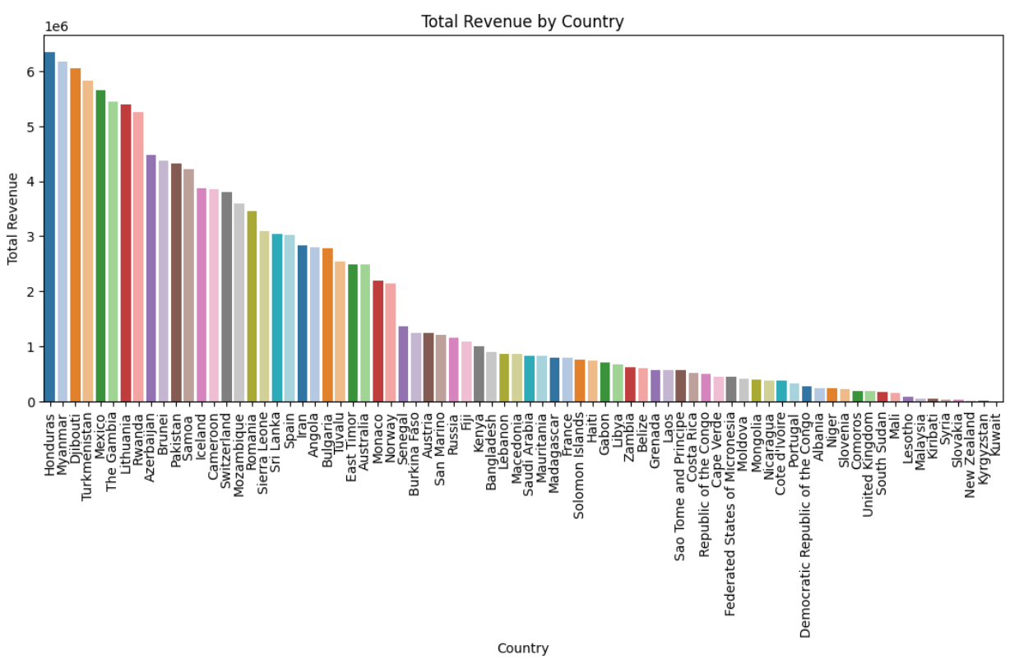
Total Revenue By Country
Highest Revenue:
Honduras
Lowest Revenue:
Kuwait
Top Five Countries:
Honduras
Myanmar
Djibouti
Turkmenistan
Mexico

Slide 17
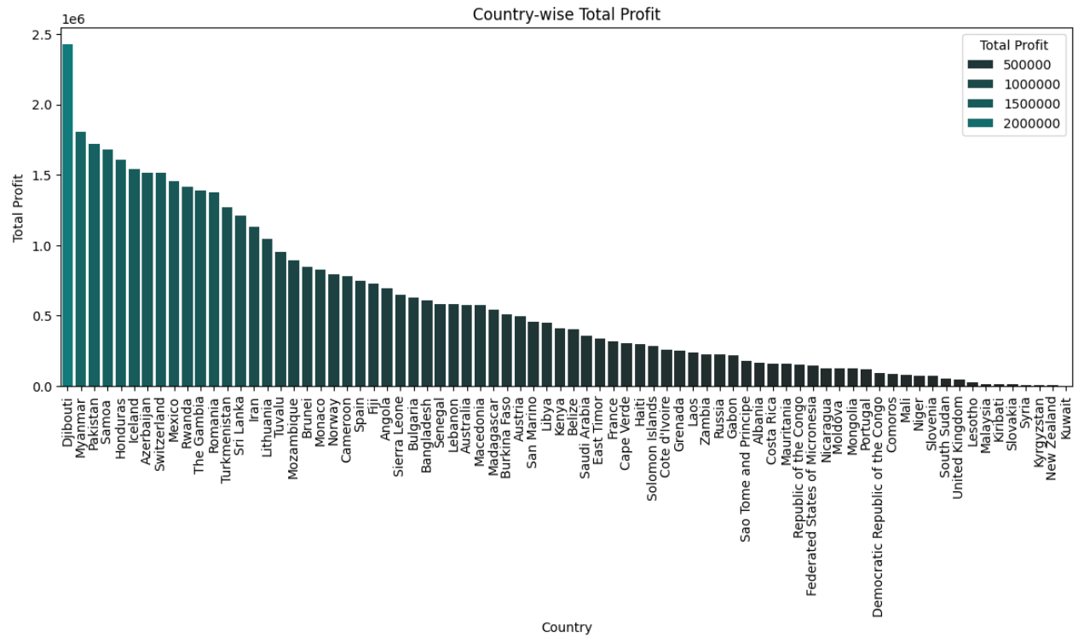
Total Profit by Country
Highest Revenue:
Djibouti
Lowest Revenue:
Kuwait
Top Five Countries:
Djibouti
Myanmar
Pakistan
Samoa
Honduras

Slide 18
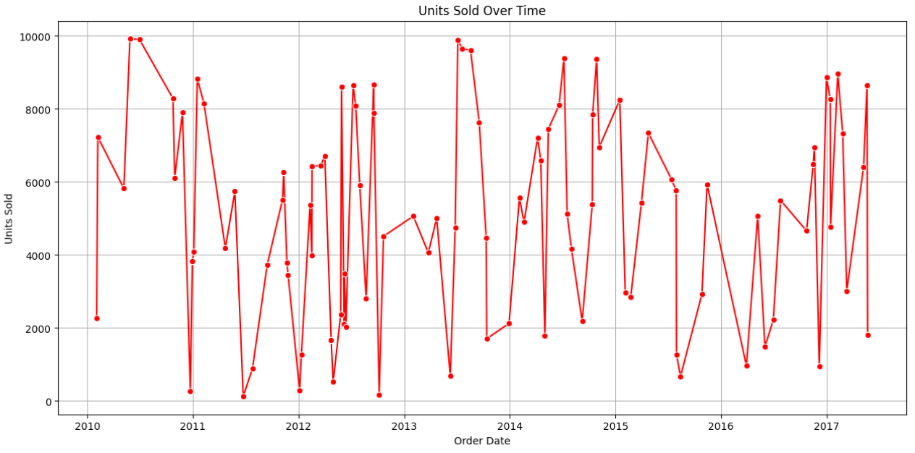
Unit Sold Over Time
2010-2011: High variability with peaks nearing 10,000 units.
2012: Drop in peak sales, fewer instances near 10,000 units.
2013: Increased volatility, highest peaks surpassing previous years.
2014-2015: Significant fluctuations, high peaks.
2016: Slight decrease in frequency and height of peak sales.
2017: Continued fluctuations, one of the highest spikes mid-year.

Slide 19
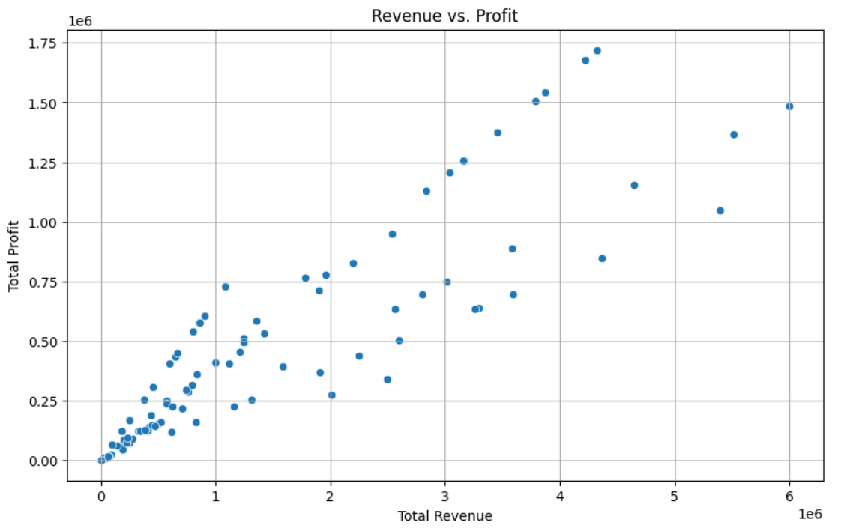
Relation Between Revenue and Profit
The scatter plot indicates a positive relationship between Total Revenue and Total Profit.
As Total Revenue increases, Total Profit also rises, shown by the upward trend of the data points.

Slide 20
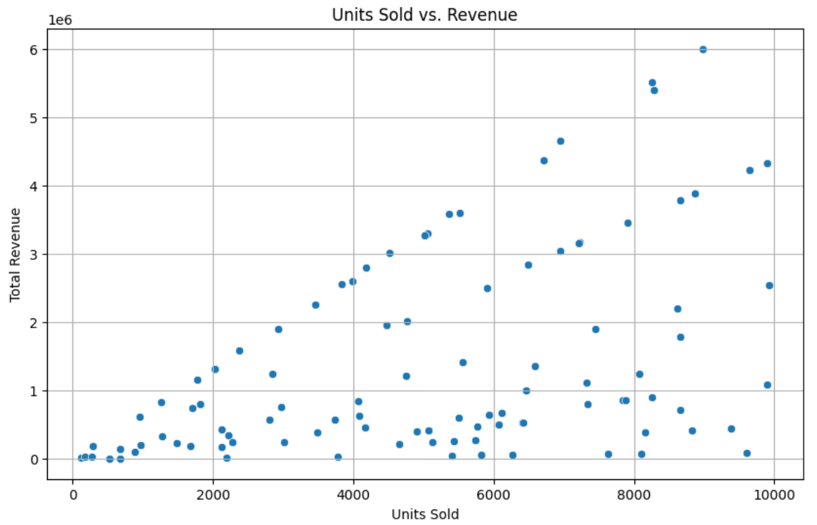
Relation Between Units Sold and Revenue
The scatter plot shows a positive relationship between Units Sold and Total Revenue.
Generally, more units sold lead to higher revenue, but some segments indicate bulk sales at lower prices.
No significant outliers are present.

Slide 21
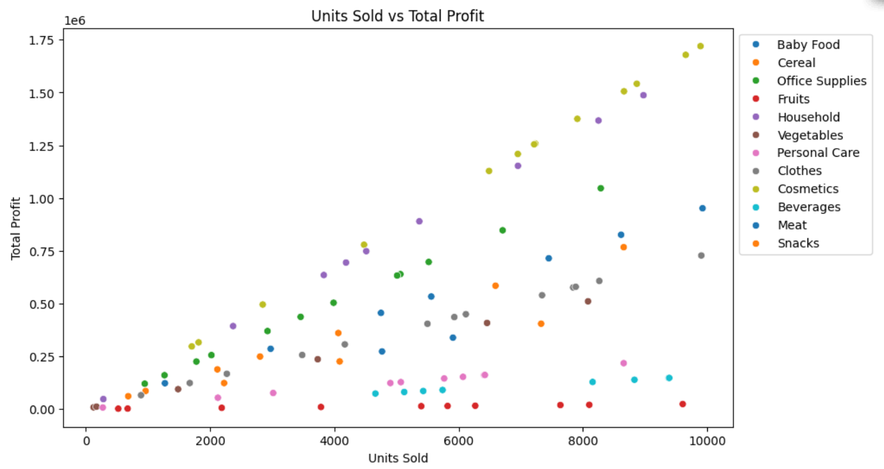
Relation Between Units Sold and Total Profit
The scatter plot shows a positive correlation between units sold and total profit.
Higher sales generally lead to higher profits.
Categories like ‘Clothes’ and ‘Cosmetics’ achieve high profits with fewer units sold, indicating higher profit margins.
‘Baby Food’, ‘Cereal’, and ‘Beverages’ show wide variability, while ‘Meat’ and ‘Snacks’ generate lower profits even at higher sales volumes.

Slide 22
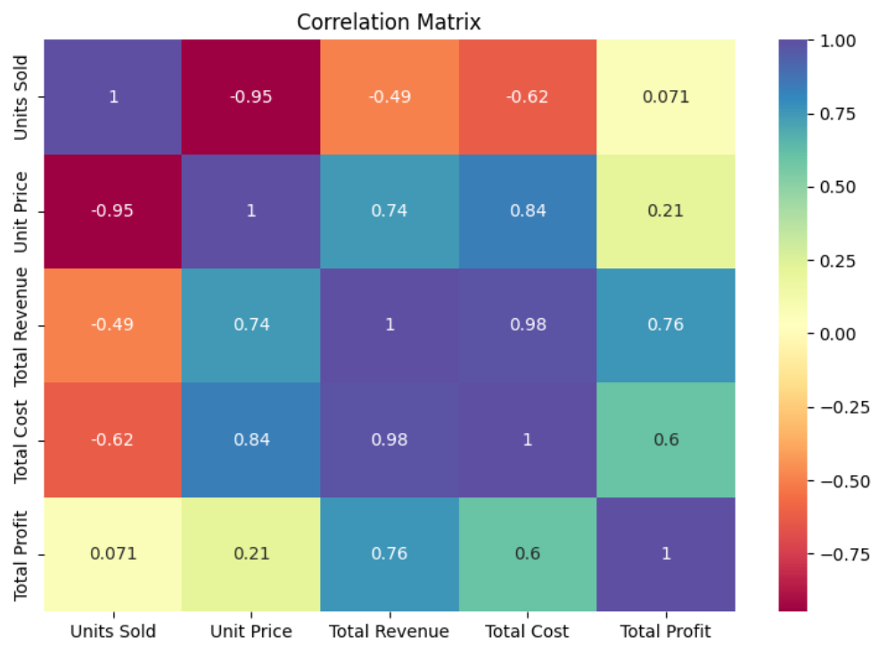
Visualizing Correlation Matrix of Numeric Columns
Units Sold & Unit Price:
Strong negative correlation (-0.95).
Total Revenue & Total Cost:
Very strong positive correlation (0.98).
Total Revenue & Total Profit:
Strong positive correlation (0.76).
Units Sold & Total Profit:
Moderate positive correlation (0.75).
Unit Price & Total Profit:
Moderate negative correlation (-0.75).
This highlights key relationships between sales, pricing, revenue, cost, and profit.

Slide 23
Conclusion
To drive Amazon's business growth, focus on optimizing inventory and marketing during peak sales months, and replicate successful strategies from past high-performing years like 2012.
Prioritizing high-margin, high-priority orders will enhance profitability.
Investing more in regions like Sub-Saharan Africa, while improving strategies in North America, will leverage regional strengths and address weaknesses.
Concentrating on profitable product lines such as cosmetics, and reassessing low-margin items like fruits and meat, will optimize the product mix.
Strengthening offline sales channels, which currently contribute significantly to revenue and profit, is crucial.

Slide 24
Conclusion
Leveraging positive correlations between key sales metrics will drive overall business growth and ensure Amazon's continued competitiveness and success.
Developing tailored strategies for top-performing countries like Honduras and Djibouti and addressing challenges in low-performing regions like Kuwait, will further enhance global performance.
Managing sales variability effectively, especially during high-variability years, will ensure stability.
Leveraging positive correlations between key sales metrics will drive overall business growth and ensure Amazon's continued competitiveness and success.

Slide 25
Data Analytics Project Report: Analyzing Bird Strikes Data (2000-2011)

Slide 26

Introduction
In today’s data-driven world, the ability to analyze and interpret data is crucial for making informed decisions. This project focuses on the analysis of bird strikes data, which is essential for improving aviation safety.
By leveraging data analytics techniques, we aim to uncover patterns and insights that can help mitigate the risks associated with bird strikes.

Slide 27

Problem Statement
Bird strikes, defined as collisions between birds and aircraft, pose significant threats to aviation safety, especially during take-off, climb, approach, and landing phases.
These incidents can cause severe damage to aircraft and have led to fatal accidents. With the increasing number of vehicles and urban expansion, addressing environmental impacts and safety concerns is crucial.
This project analyzes bird strike data collected by the FAA from 2000-2011 to uncover patterns and inform strategies for mitigating risks.

Slide 28

Objectives
Analyze Bird Strikes Data: Examine data collected on bird strikes by the FAA between 2000-2011 to understand trends and patterns.
Visualize Key Metrics: Create visualizations to depict the number of bird strikes, yearly analysis, top airlines and airports affected, and the cost incurred due to bird strikes.

Slide 29
Objectives
Identify High-Risk Phases: Determine when most bird strikes occur, the altitude of airplanes at the time of strikes, and the phase of flight during strikes.
Evaluate Impact: Assess the effect of bird strikes on flights, including the impact at different altitudes and whether pilots were informed or had prior warnings.

Slide 30
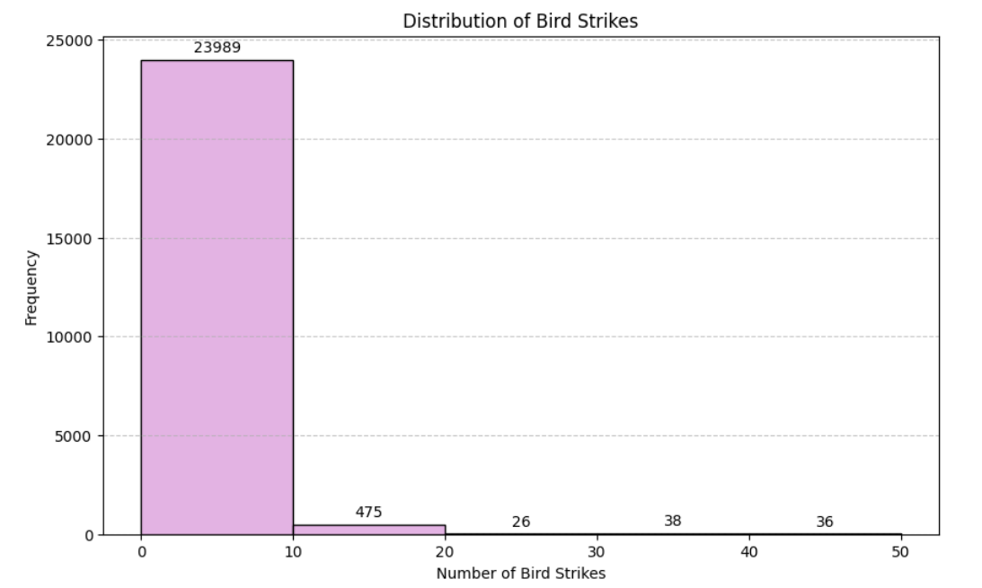
Visuals Depicting the number of Bird Strikes

Slide 31
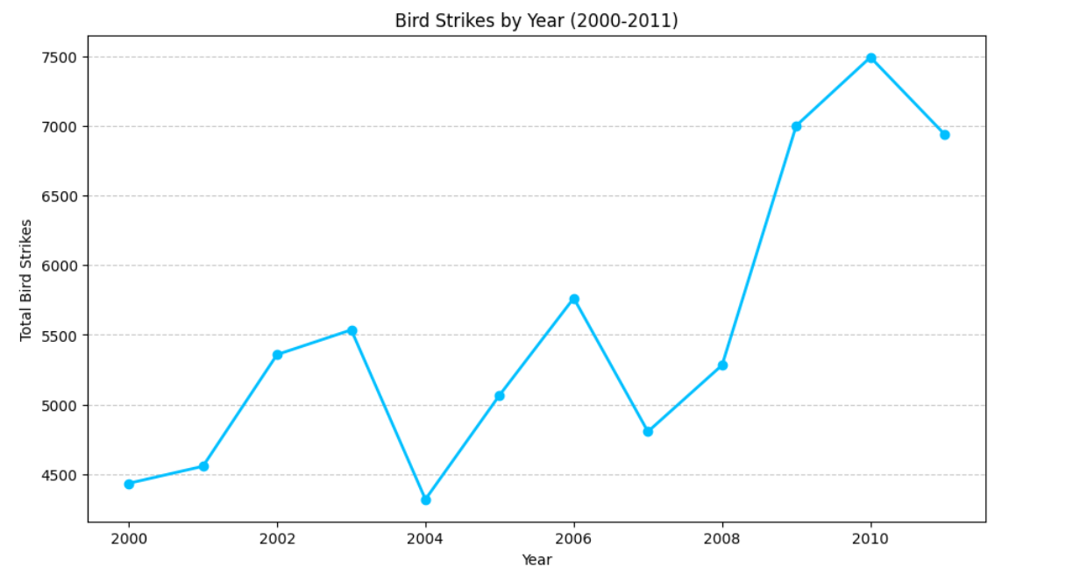
Yearly Analysis of Bird Strikes in US
The highest number of bird strikes increased in 2010.
The lowest in 2004 and 2000.

Slide 32
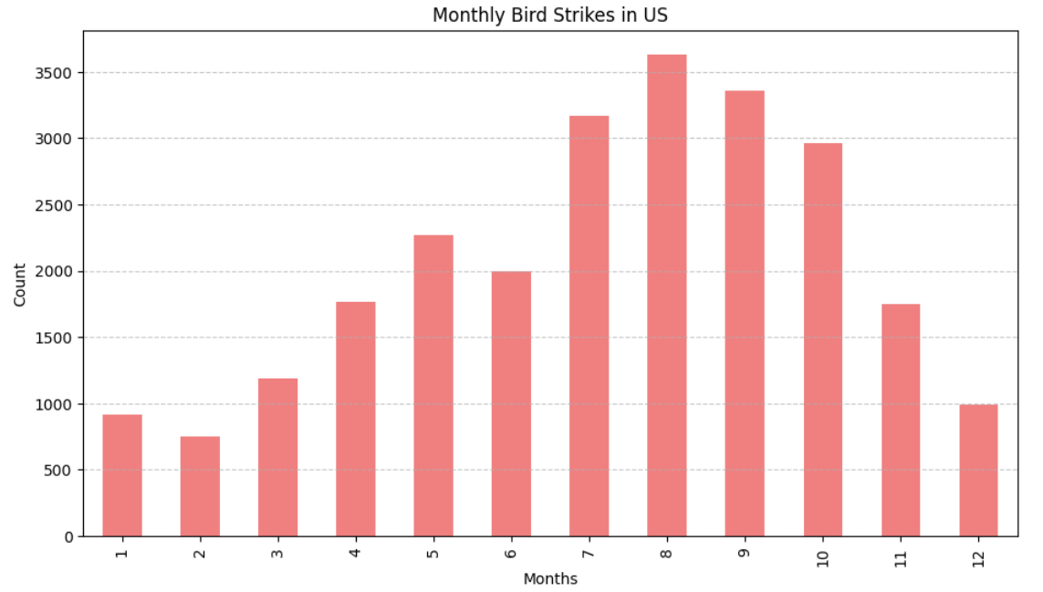
Monthly Analysis of Bird Strikes in US
Peak Months: July to October.
Lowest Months: January and February.
Trend: Noticeable increase in bird strikes starting from July, peaking in September, and then gradually decreasing.

Slide 33
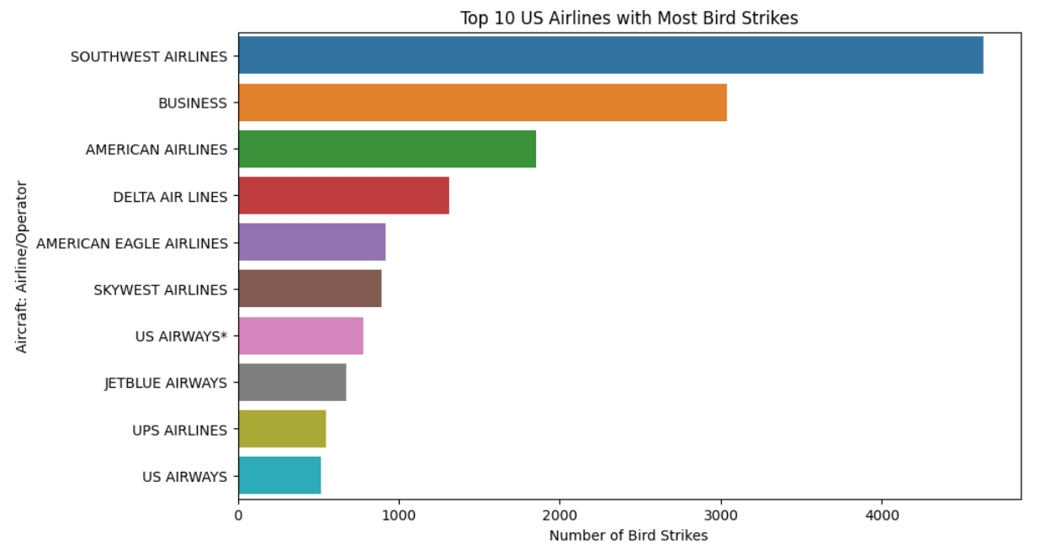
Top 10 US Airlines with Most Bird Strikes

Slide 34
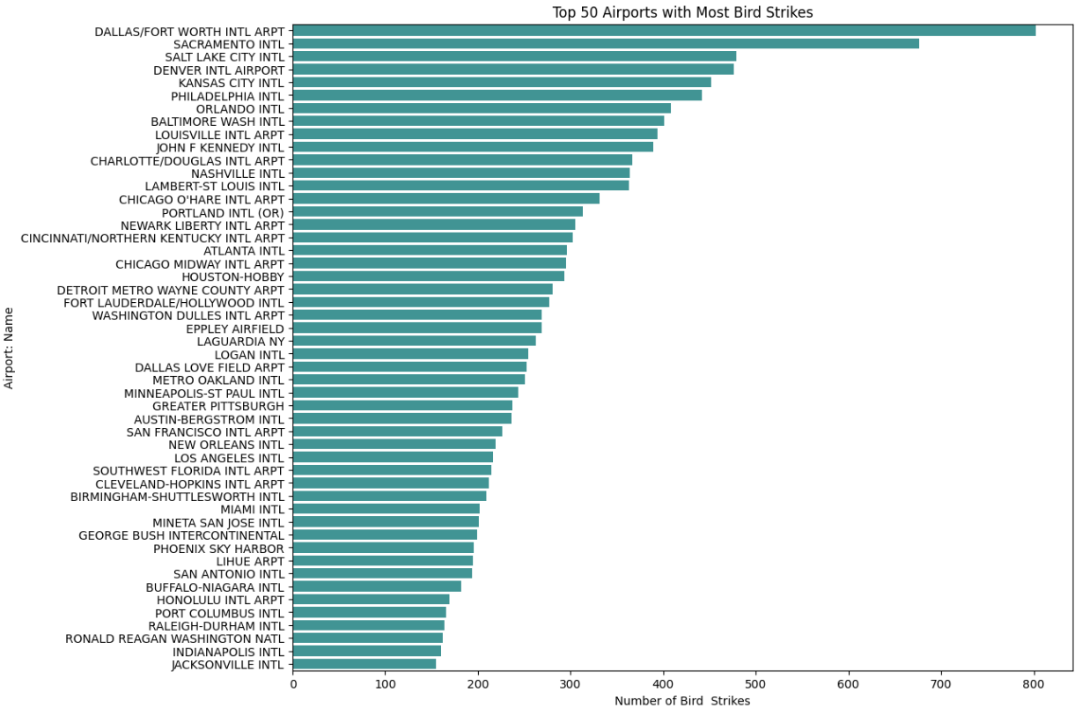
Top 50 Airports with Most Bird Strikes

Slide 35
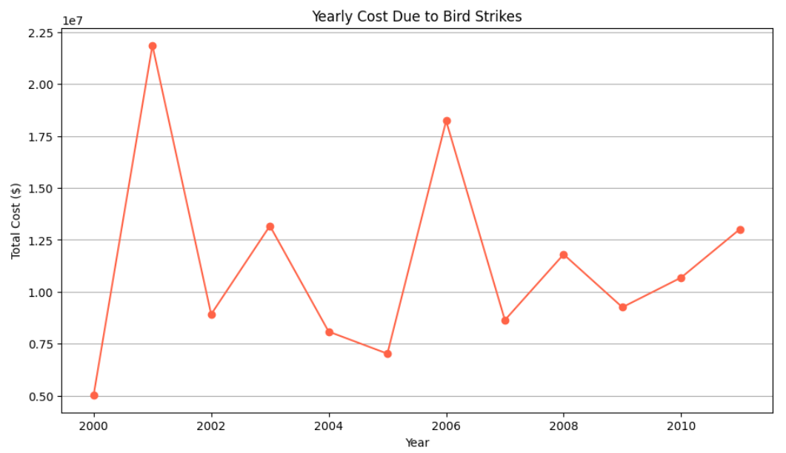
Yearly Cost Due to Bird Strikes
The cost spike notably in 2001, 2003, 2006 and 2011

Slide 36
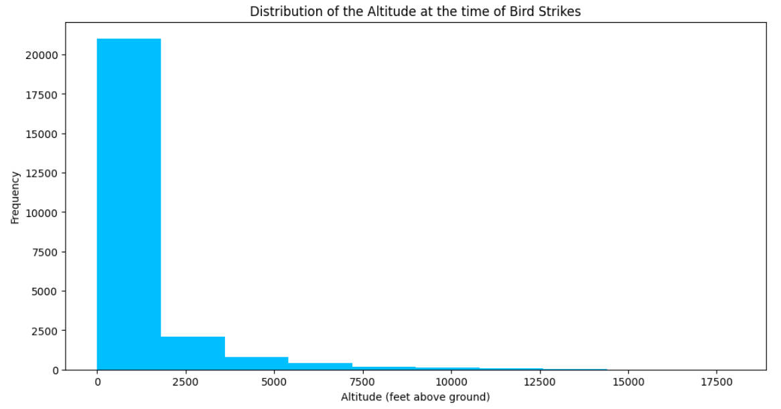
Distribution of the Altitude at the time of Bird Strikes
Mostly Altitude of the Airplane between 0-2000 when the Bird Strikes

Slide 37
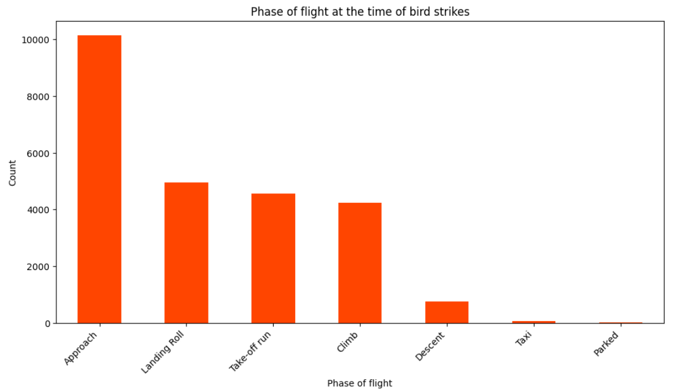
Phase of Flight at the Time of Bird Strikes
The highest number of bird strikes occur during the approach phase, with count. close to 10,000.
Landing Roll, Take-off Run, and Climb: significant number of bird strikes
Descent, Taxi, and Parked: These phases have much lower counts of bird strikes.

Slide 38
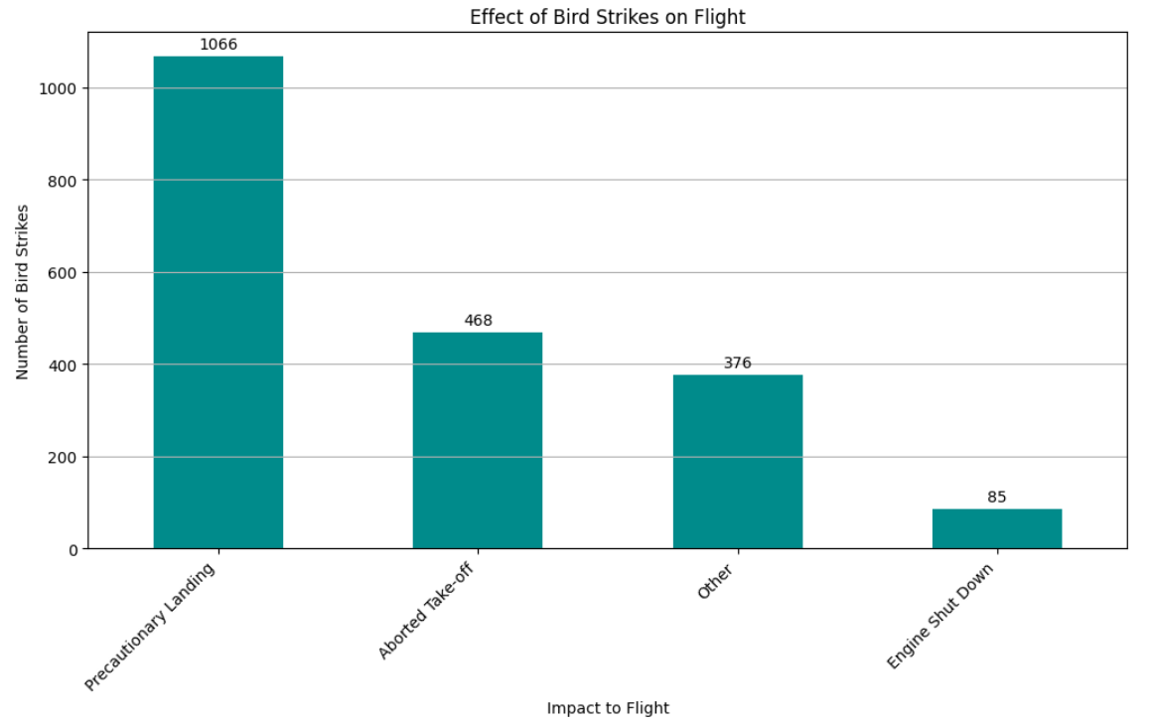
Effect of Bird Strikes on Flight
The most common result is Precautionary Landings, followed by Aborted Takeoffs.
Engine Shutdowns are the least common but still significant.

Slide 39
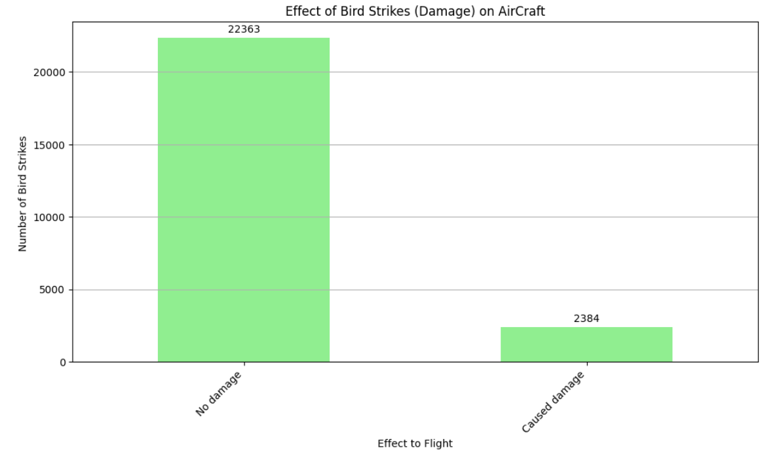
Effect of Bird Strikes (Damage) on Aircraft
Most Bird Strikes caused No damage.
Caused damage is least but still significant because of Cost to Repair.

Slide 40
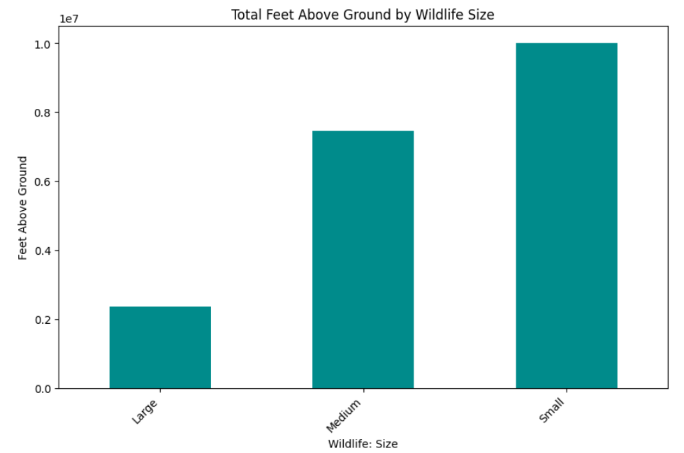
Total Feet Above Ground by Wildlife Size
Small Birds: Most frequently involved in bird strikes at higher altitudes.
Medium Birds: Also significantly involved in bird strikes, but less than small birds.
Large Birds: Least frequently involved in bird strikes at higher altitudes.

Slide 41
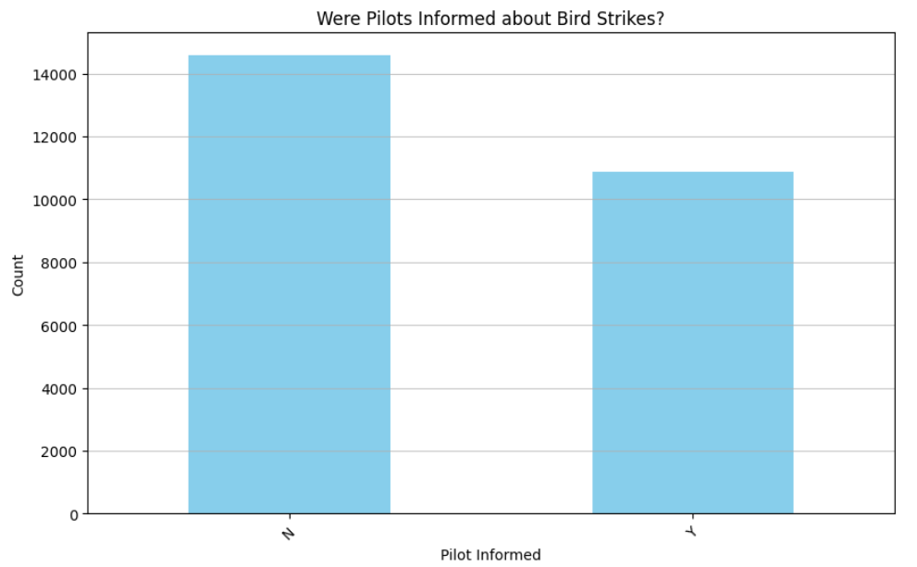
Were Pilots Informed about Bird Strikes?
Most Pilots were not informed about the Bird Strikes. This can lead to serious issues in the Aircraft.
Fewer pilots were informed about the Bird Strikes.

Slide 42
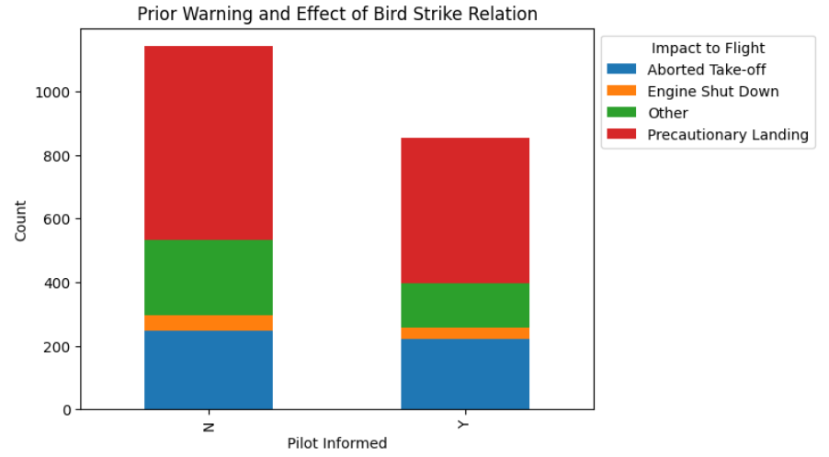
Impact of Bird Strikes with Pilot Warning
Pilot Informed: When pilots are informed about birds or wildlife, there are fewer severe impacts like engine shutdowns and aborted take-offs.
Pilot Not Informed: When pilots are not informed, there are more precautionary landings and other impacts.
Overall Trend: Prior warning to pilots reduces bird strike severity, highlighting the need for effective communication and early alerts.

Slide 43
Key Findings
Frequency and Timing of Bird Strikes:
Bird strikes are most frequent during takeoff, initial climb, approach, and landing phases due to the lower altitude.
Majority of strikes occur below 1,000 feet, highlighting the increased risk during these flight phases.

Slide 44
Key Findings
Impact on Aircraft:
Many bird strikes lead to significant aircraft damage, including engine shutdowns and precautionary landings..
Both small and large aircraft are affected, with jet engines being particularly vulnerable.

Slide 45
Key Findings
Seasonal and Temporal Trends:
Bird strikes show seasonal patterns, with higher occurrences in certain months.
Time of day also influences strike frequency, with more incidents occurring during daylight hours.

Slide 46
Key Findings
Geographical Distribution:
Certain airports and regions report higher numbers of bird strikes, indicating hotspots that may require targeted interventions.
Effect of Wildlife Size and Species:
Larger birds tend to cause more damage compared to smaller birds.
Specific species are more frequently involved in strikes, suggesting a need for species-specific management strategies.

Slide 47
Key Findings
Pilot Awareness and Warning Systems:
A significant number of incidents occur without prior warning to pilots.
Effective communication and warning systems are crucial in mitigating risks.

Slide 48
Conclusion
The analysis of bird strikes reveals that these incidents predominantly occur during the critical flight phases of takeoff, initial climb, approach, and landing, largely below 1,000 feet, making these phases particularly vulnerable.
Bird strikes often lead to significant aircraft damage, including engine shutdowns and precautionary landings, with both small and large aircraft, particularly those with jet engines, being highly susceptible.

Slide 49
Conclusion
The data shows distinct seasonal and daily patterns, with higher occurrences during certain months and daylight hours, indicating the need for heightened mitigation efforts during these times.
Geographically, specific airports and regions experience higher bird strike incidents, necessitating targeted interventions.
Larger birds and certain species cause more damage, underscoring the importance of species-specific management strategies.

Slide 50
Conclusion
Additionally, many strikes occur without prior warning to pilots, highlighting the critical need for improved communication and warning systems.
To effectively reduce the risk and impact of bird strikes, comprehensive wildlife management programs, advanced detection and monitoring systems, enhanced pilot training, aircraft design improvements, and robust communication systems are essential, ensuring greater overall flight safety.

Slide 51

AtliQ Hospitality Analysis Report

Slide 52

Introduction
Atliq Grands, a prominent player in the Indian hospitality industry for over 20 years, is facing challenges due to strategic moves by competitors and ineffective management decisions.
To regain market share and revenue in the luxury/business hotels category, the managing director has decided to incorporate Business and Data Intelligence.
Without an in-house data analytics team, they have hired a third-party service provider to analyze historical data and provide actionable insights.
The goal is to leverage data-driven strategies to enhance decision-making and improve overall performance.

Slide 53

Problem Statement
Atliq Grands, a chain of five-star hotels across India, is losing market share and revenue in the luxury/business hotels category due to strategic moves from competitors and ineffective decision-making in management.
To regain their market share and revenue, the managing director wants to incorporate “Business and Data Intelligence.”
However, they lack an in-house data analytics team and have decided to hire a third-party service provider to gain insights from their historical data.

Slide 54
Objective
Analyze Historical Data: Utilize historical data to identify trends and patterns in revenue, occupancy rates, and customer ratings.
Strategic Insights: Provide actionable insights to improve decision-making and strategic planning.
Market Share Recovery: Develop strategies to regain market share and enhance revenue in the luxury/business hotels category.
Performance Metrics: Establish key performance indicators (KPIs) to monitor and evaluate the effectiveness of implemented strategies.

Slide 55
Details of Data
The Dataset includes 5 CSV files named as:
dim_date.csv
dim_hotels.csv
dim_rooms.csv
fact_aggregated_bookings.csv
fact_bookings.csv

Slide 56

Main KPIs
Revenue - Sum of revenue_realized
Total Bookings - Count of booking_id in fact_bookings
Average Rating - Average of ratings_given
Total Capacity - Sum of capacity
Total Succesful bookings - Sum of successful_bookings from fact_bookings

Slide 57

Main KPIs
Occupancy % - Ratio of Total Successful Bookings to Total Capacity
Total Cancelled Bookings - Count of booking_id in which
booking_status = "Cancelled“
Cancellation Rate - Ratio of 'Total Cancelled Bookings' to 'Total Bookings'

Slide 58

Dashboard

Slide 59
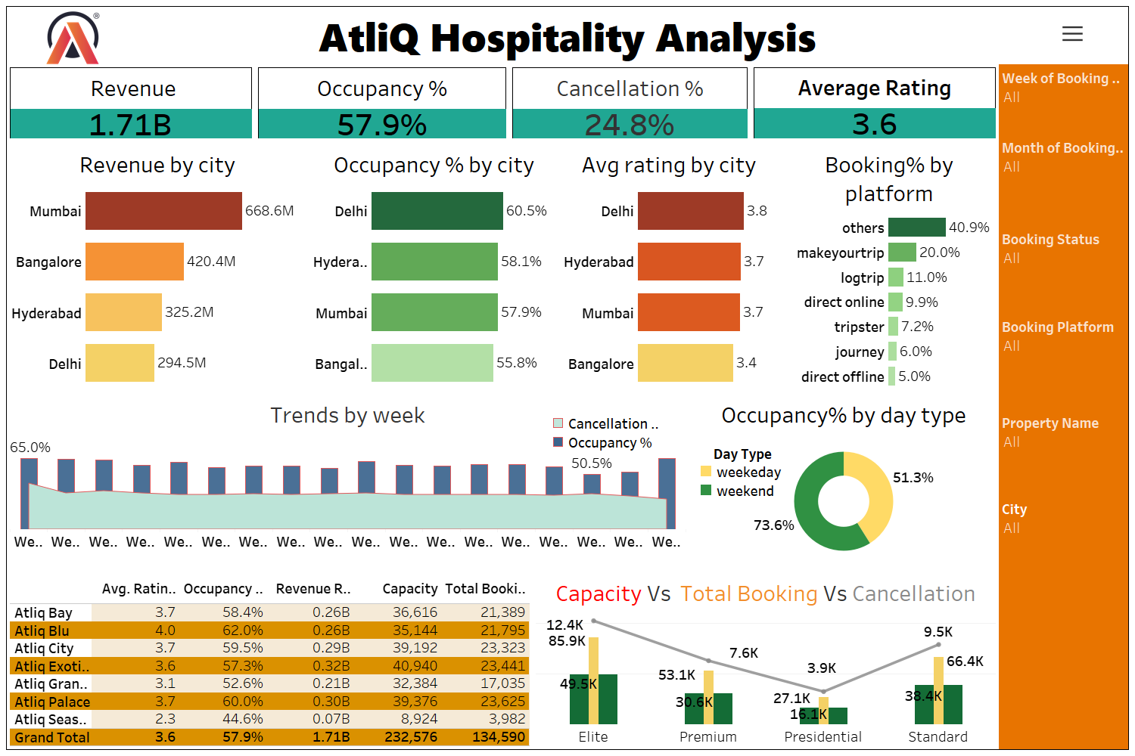

Slide 60
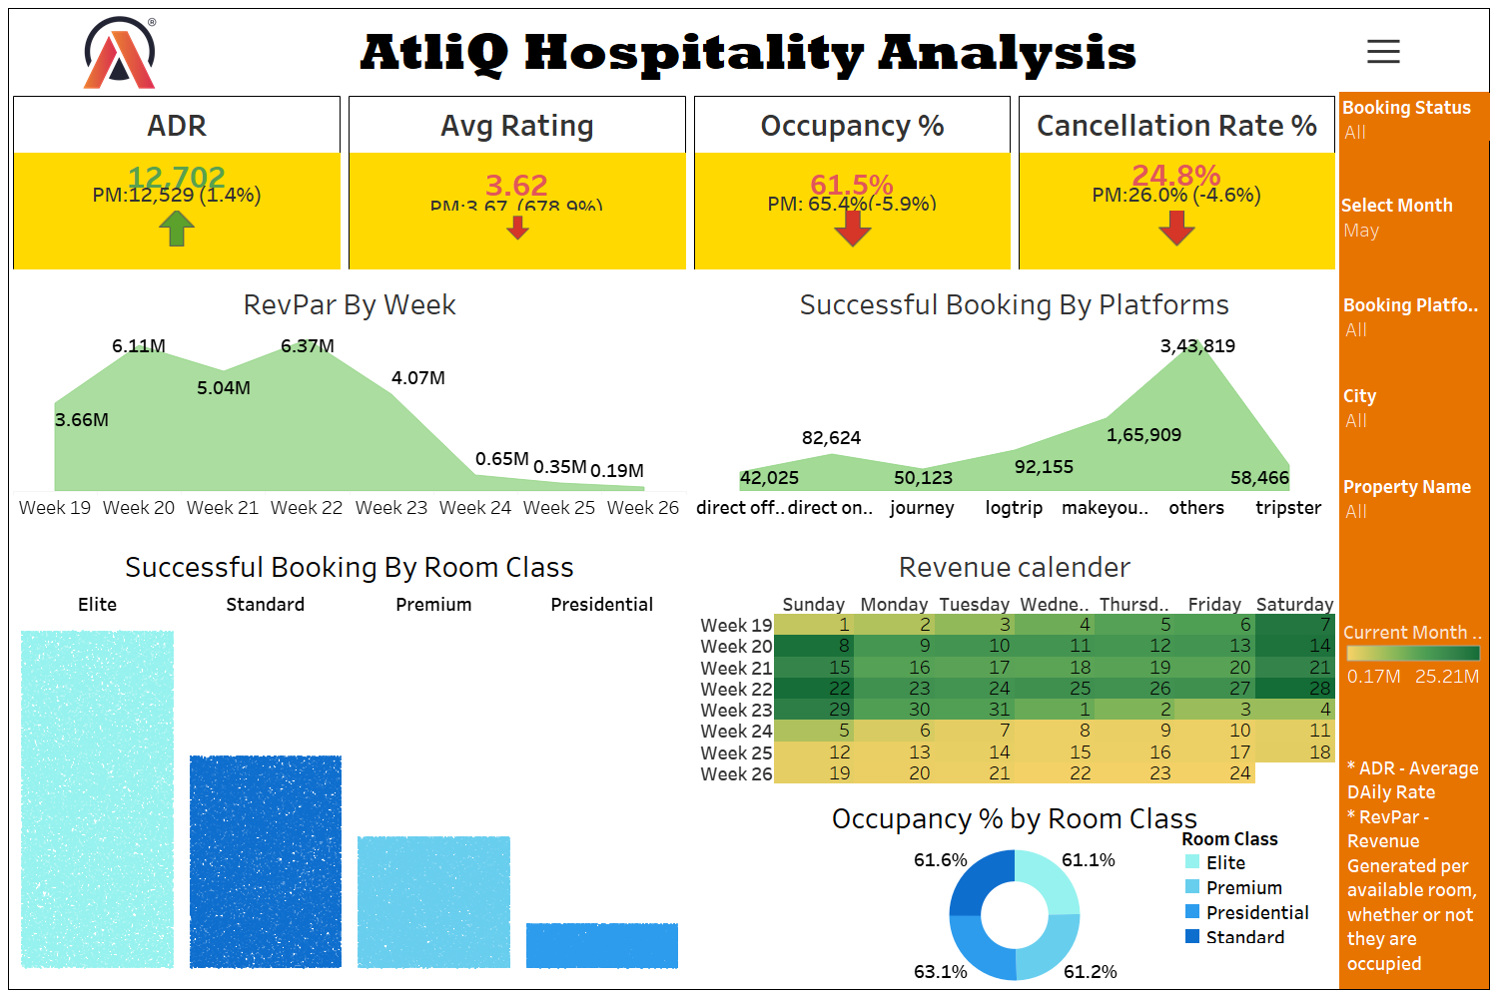

Slide 61

Thank You

